Slide 1
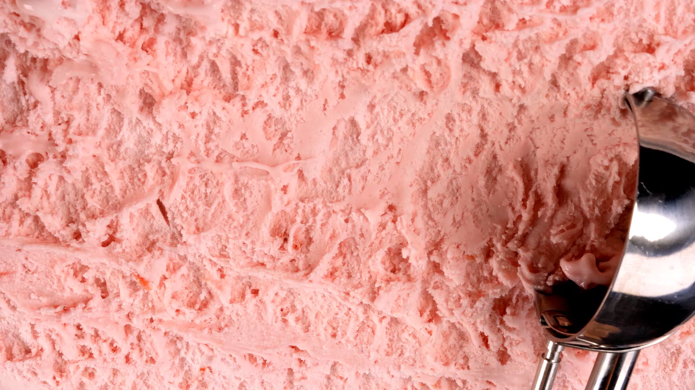
Building Delicious Web Experiences: A Look at Our Frozen Treats
LE MINH DANH
Notes:
Good morning/afternoon, everyone!
Today, I'm excited to take you behind the scenes of a website we've built, focusing on a delightful topic: frozen desserts! We'll explore how it works, the technologies we used, and what the future might hold for it.
Think of this as a masterclass in building simple, effective websites using the foundational languages of the web.

Slide 2
Building Delicious Web Experiences: A Look at Our Frozen Treats
See Our Sweet Creations!
• What is this website? A digital showcase for delicious frozen desserts like Gelato, Bingsu, and Ice Pops.
• Our Goals: To create an inviting, easy-to-navigate space where users can discover and learn about these treats.
• Key Focus: Introducing the unique appeal of each dessert.
• Presentation Roadmap:
1. Website Functions
2. The Code Behind It (HTML & CSS)
3. Future Enhancements
LE MINH DANH
Notes:
So, what are we looking at? This website is all about celebrating amazing frozen desserts!
Our main goal was to make it super simple and fun for anyone to explore.
We wanted to introduce you to cool treats like Italian Gelato, Korean Bingsu, and refreshing Ice Pops.
Today, we'll cover what you can do on the site, the core technologies we used to build it – which are HTML and CSS – and then we'll brainstorm some exciting ideas for how it could grow even bigger and better in the future."

Slide 3
See Our Sweet Creations!
Exploring the Site: User Experience
• What is this website? A digital showcase for delicious frozen desserts like Gelato, Bingsu, and Ice Pops.
• Our Goals: To create an inviting, easy-to-navigate space where users can discover and learn about these treats.
• Key Focus: Introducing the unique appeal of each dessert.
• Presentation Roadmap:
1. Website Functions
2. The Code Behind It (HTML & CSS)
3. Future Enhancements
• Discover Desserts: Learn about the origins and characteristics of Gelato, Bingsu, and Ice Pops on the homepage.
• Navigate Recipes: Click through to dedicated recipe pages for each dessert type.
• Access Key Pages: Easily find more information via:
O Menu
O Contact Us
O About Us
• Promotional Banner: Stay updated on special offers (e.g., Mid-Autumn Festival deals).
Notes:
Let's talk about what users can actually do when they visit our site.
First off, they can get introduced to these wonderful desserts right on the homepage.
Then, if they're curious about how to make them, or just want to know more, they can click over to specific recipe pages.
We've also made sure there are clear links to other important sections like a full Menu, a Contact page if they want to get in touch, and an About Us page to learn more about who's behind this sweet venture.
You might also notice a special banner up top – it’s a way to highlight current promotions or news!"

Slide 4
Exploring the Site: User Experience
Meet the Desserts!
• Discover Desserts: Learn about the origins and characteristics of Gelato, Bingsu, and Ice Pops on the homepage.
• Navigate Recipes: Click through to dedicated recipe pages for each dessert type.
• Access Key Pages: Easily find more information via:
O Menu
O Contact Us
O About Us
• Promotional Banner: Stay updated on special offers (e.g., Mid-Autumn Festival deals).
• Homepage Introduction: Engaging descriptions of Gelato (rich, velvety, Italian) and Bingsu (Korean, shaved ice).
• Recipe Pages: Detailed guides (linked from homepage/nav) for:
O Gelato
O Bingsu
O Ice Pops
• Navigation Structure:
O Main links: [Recipes], [Menu], [Contact Us], [About Us]
O Recipe links: [Gelato], [Bingsu], [Icepop]
• Visual Appeal: (Implied) Use of images to showcase the desserts.
Notes:
Let's dive a little deeper into the content.
On the homepage, we give you a little 'taste' of what Gelato and Bingsu are all about, explaining their unique qualities – like Gelato being Italian, super smooth, and Bingsu being a refreshing Korean shaved ice treat.
Then, from the homepage or the main navigation, you can jump directly to detailed recipe pages for Gelato, Bingsu, and Ice Pops.
The navigation is designed to be super intuitive, with clear links to Recipes, Menu, Contact, and About Us, and then more specific recipe links once you're in the recipe section."

Slide 5
Meet the Desserts!
Under the Hood: HTML
• Homepage Introduction: Engaging descriptions of Gelato (rich, velvety, Italian) and Bingsu (Korean, shaved ice).
• Recipe Pages: Detailed guides (linked from homepage/nav) for:
O Gelato
O Bingsu
O Ice Pops
• Navigation Structure:
O Main links: [Recipes], [Menu], [Contact Us], [About Us]
O Recipe links: [Gelato], [Bingsu], [Icepop]
• Visual Appeal: (Implied) Use of images to showcase the desserts.
• Html Tags: We use tags that describe the content's purpose:
O <header>, <nav>, <main>, <section>, <footer>
O <h1> to <h6> for headings, <p> for paragraphs, <ul>/<ol> for lists.
• Content Organization: HTML structures the text, images, and links into logical blocks.
• Linking Pages: Uses <a> (anchor) tags to connect different parts of the site and external resources.
Notes:
Now, let's peek under the hood! The foundation of any website is HTML.
We're using HTML tags like <header> for the top part of the page, <nav> for navigation menus, <main> for the core content, and so on.
This makes the site not only organized for us developers but also much better for search engines.
We also use headings, paragraphs, and lists to organize text, and crucially, <a> tags to create all the links that let you move around the site."

Slide 6
Under the Hood: HTML
Under the Hood: CSS
• Html Tags: We use tags that describe the content's purpose:
O <header>, <nav>, <main>, <section>, <footer>
O <h1> to <h6> for headings, <p> for paragraphs, <ul>/<ol> for lists.
• Content Organization: HTML structures the text, images, and links into logical blocks.
• Linking Pages: Uses <a> (anchor) tags to connect different parts of the site and external resources.
• CSS: We use CSS to control the design, look, and layout of HTML elements.
• Visual Design:
O Colors: Setting background colors, text colors, link colors.
O Typography: Choosing fonts, font sizes, and line spacing.
O Spacing: Controlling margins and padding around elements.
• Layout: Arranging content blocks on the page (e.g., aligning text, positioning elements).
• Interactive Elements: Styling links and buttons to indicate they are clickable.
Notes:
If HTML is the skeleton, CSS is the skin, the clothes, and the makeup!
CSS makes our website look good. It's responsible for all the visual aspects.
We use CSS to pick our color schemes.
We choose the fonts to make the text readable and appealing. CSS also handles all the spacing between paragraphs, or around images.
Importantly, it controls the layout, telling elements where to sit on the page. Even though this site is simple, CSS helps make it look clean and professional"

Slide 7
Under the Hood: CSS
What's Next for Our Dessert Site?
• CSS: We use CSS to control the design, look, and layout of HTML elements.
• Visual Design:
O Colors: Setting background colors, text colors, link colors.
O Typography: Choosing fonts, font sizes, and line spacing.
O Spacing: Controlling margins and padding around elements.
• Layout: Arranging content blocks on the page (e.g., aligning text, positioning elements).
• Interactive Elements: Styling links and buttons to indicate they are clickable.
• Add Interactivity with JavaScript:
O Recipe Helpers: Ingredient calculators, step-by-step toggles.
O Image Galleries/Carousels: Showcase more enticing photos.
O Animations: Smooth transitions, hover effects for buttons.
O Enhanced User Experience:
O Search Bar: Quickly find specific recipes.
O Filtering: Sort recipes by type, difficulty, or ingredients.
• Backend Integration:
O Contact Form: Allow users to send messages directly from the site.
O User Submissions: Potentially allow users to share their own dessert recipes.
Notes:
While our HTML/CSS site is great, there's always room to grow! The most obvious next step is to introduce JavaScript.
This will unlock a world of possibilities. Imagine interactive recipe guides where you can check off steps, or ingredient calculators that adjust quantities.
We could add beautiful image galleries to really make the desserts pop!
We could also add a search bar so you can instantly find that perfect ice pop recipe.
And to make it a true platform, we could build a contact form so users can easily message us or even allow them to submit their own creations! These are just a few ideas to make our dessert site even more engaging and useful."

Slide 8
What's Next for Our Dessert Site?
Sweet Success!
• Add Interactivity with JavaScript:
O Recipe Helpers: Ingredient calculators, step-by-step toggles.
O Image Galleries/Carousels: Showcase more enticing photos.
O Animations: Smooth transitions, hover effects for buttons.
O Enhanced User Experience:
O Search Bar: Quickly find specific recipes.
O Filtering: Sort recipes by type, difficulty, or ingredients.
• Backend Integration:
O Contact Form: Allow users to send messages directly from the site.
O User Submissions: Potentially allow users to share their own dessert recipes.
• Recap: We've explored our frozen dessert website – its function, design, and the HTML/CSS foundation.
• Key Takeaway: Understanding core web technologies is crucial for building engaging online experiences.
• The Journey: From a simple HTML/CSS structure to exciting future possibilities.
• Questions? Open floor for any queries.
• Thank You!
Notes:
So, to wrap things up, we've taken a deep dive into our frozen dessert website.
We've seen how it functions, appreciated its clean design, and understood the fundamental role of HTML and CSS in building it.
The key message is that even with just these core technologies, you can create a functional and appealing website.
This project shows the journey from a basic structure to thinking about advanced features.
Thank you all for your attention! I'm now happy to open the floor for any questions you might have."

Slide 9
Sweet Success!
THANK YOU FOR LISTENING!
• Recap: We've explored our frozen dessert website – its function, design, and the HTML/CSS foundation.
• Key Takeaway: Understanding core web technologies is crucial for building engaging online experiences.
• The Journey: From a simple HTML/CSS structure to exciting future possibilities.
• Questions? Open floor for any queries.
• Thank You!
Notes:
Speaking Notes: “Thank you all for listening!”

